Slide 1
Group 8: Scalable Matrix Multiplication Accelerator
羅允辰, 李冠霈, 王睿瑄
高階合成技術於應用加速-Final Project

Slide 2
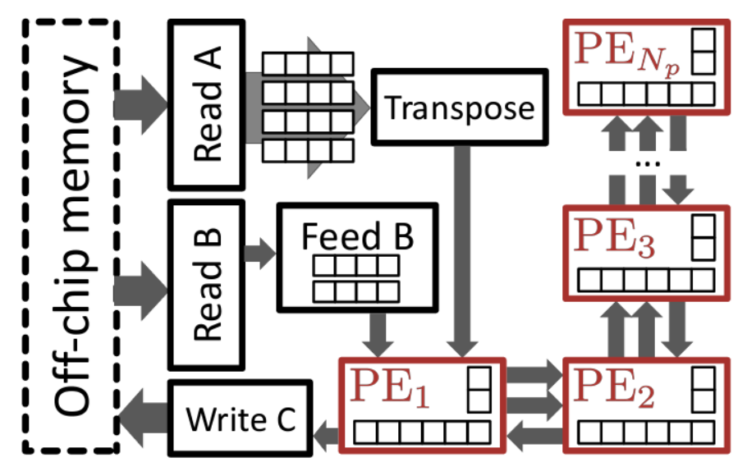
Overall Procedure
Initialize OpenCL & others
Copy matrix (host→device)
Execute Kernel
Copy result (device→host)
5. Compute golden on host
6. Verify the result
③
FPGA+HBM
Host
②
B
⑤
C
A
=
⑥
C
④

Slide 3
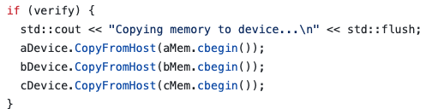
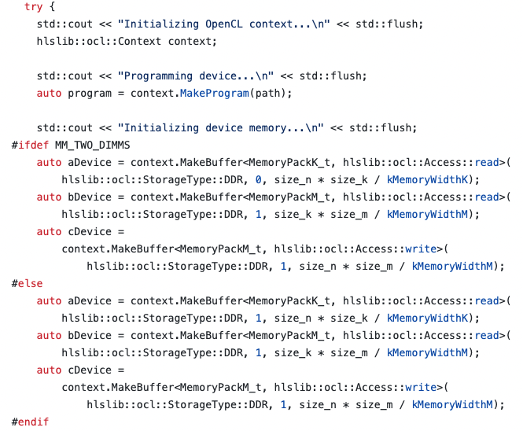
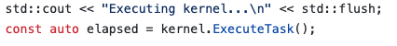
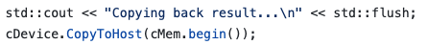
Overall Procedure
②
①
③
④
③
FPGA+HBM
Host
②
①
B
⑤
C
A
=
⑥
C
④

Slide 4
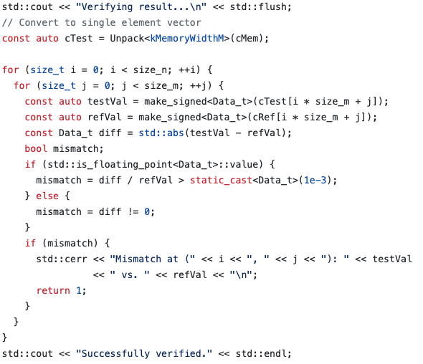
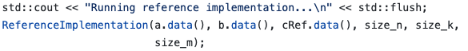
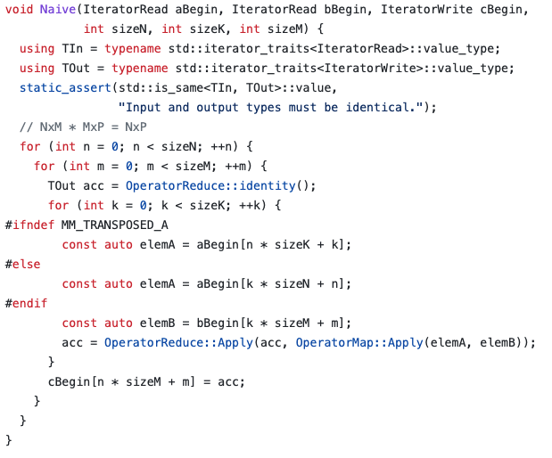
Overall Procedure
⑥
⑤
③
FPGA+HBM
Host
②
①
B
⑤
C
A
=
⑥
C
④

Slide 5
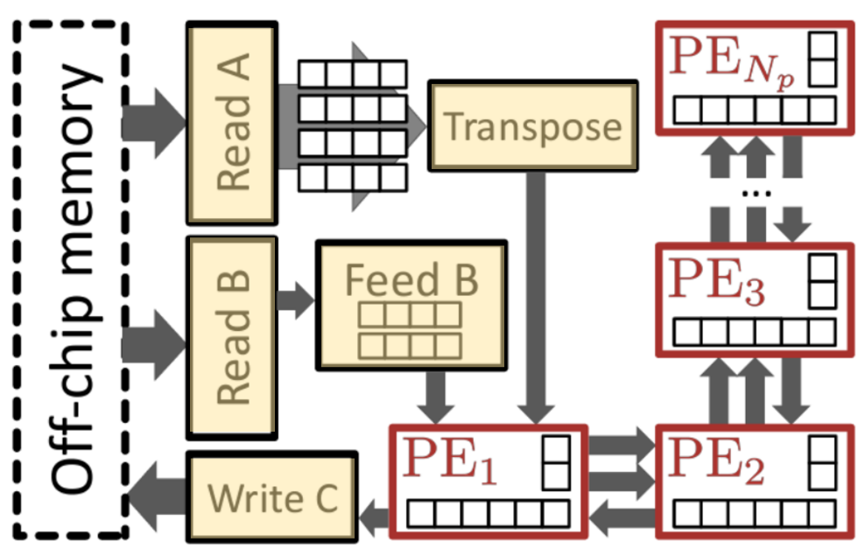
Memory-related

Slide 6
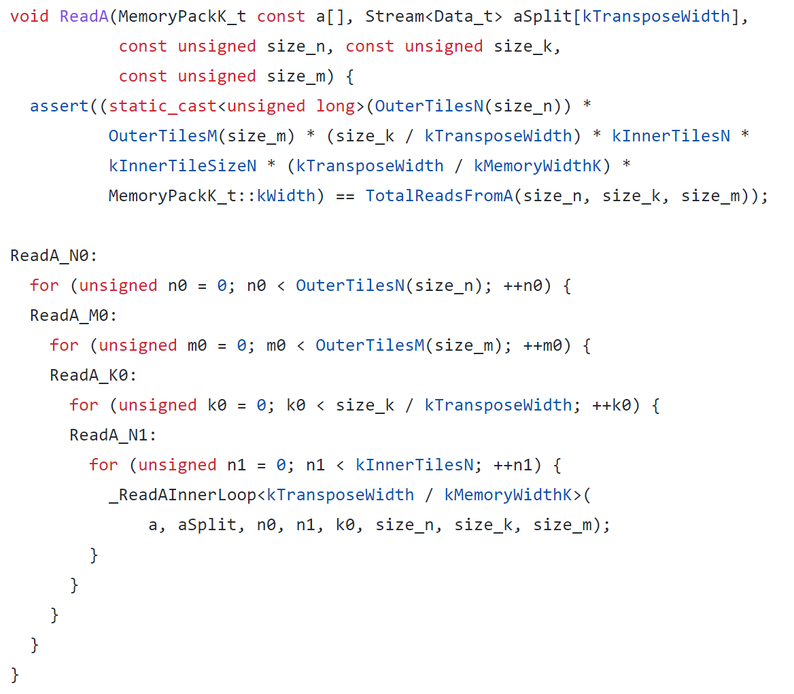
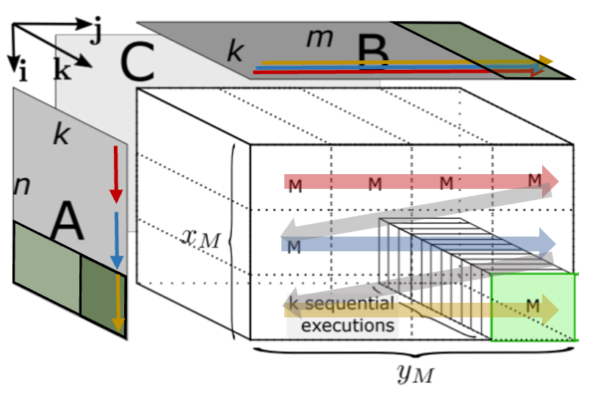

Read A

Slide 7
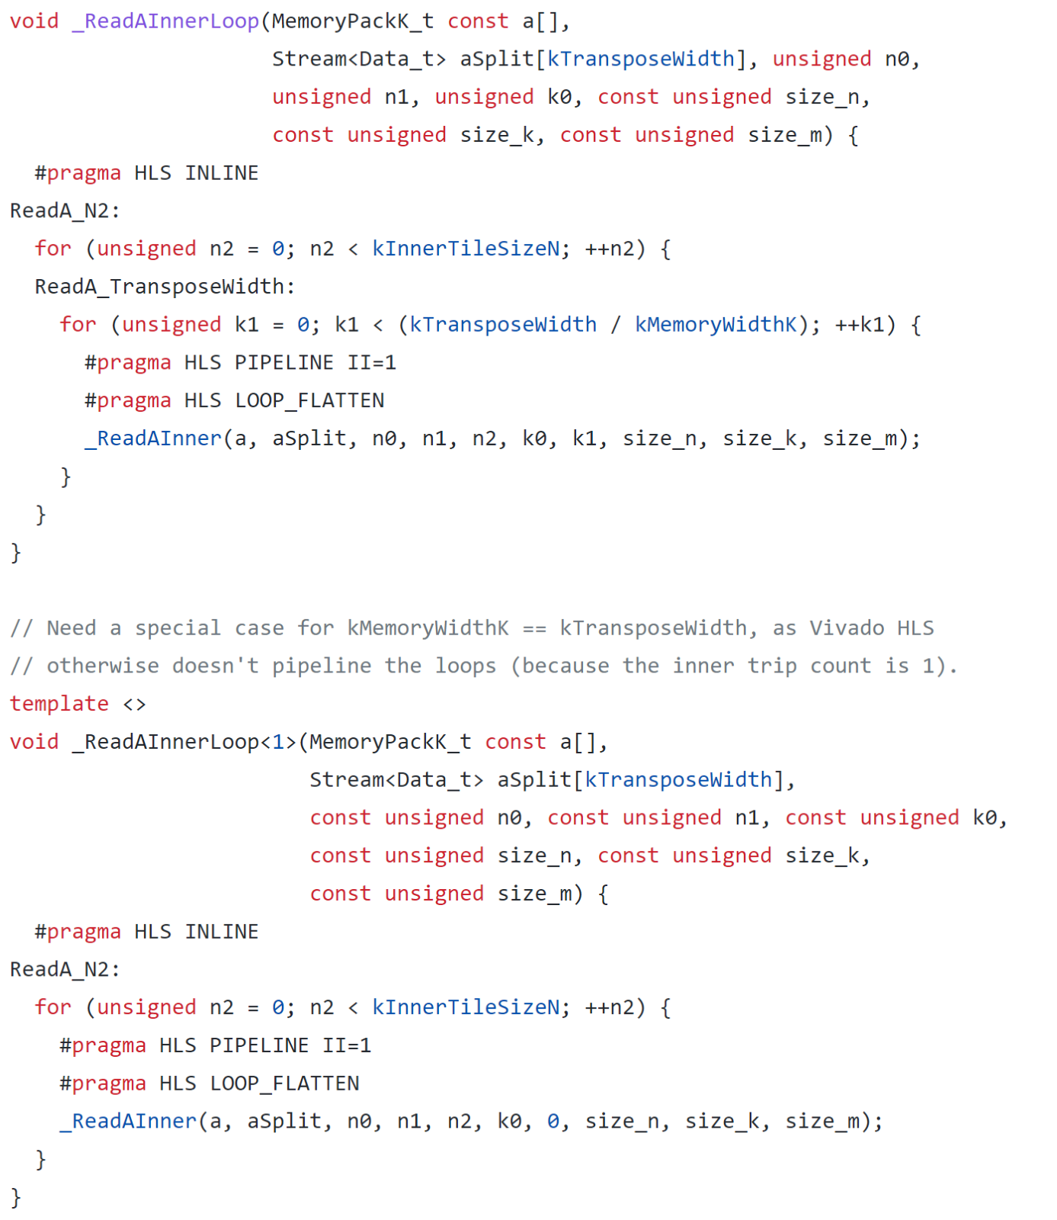
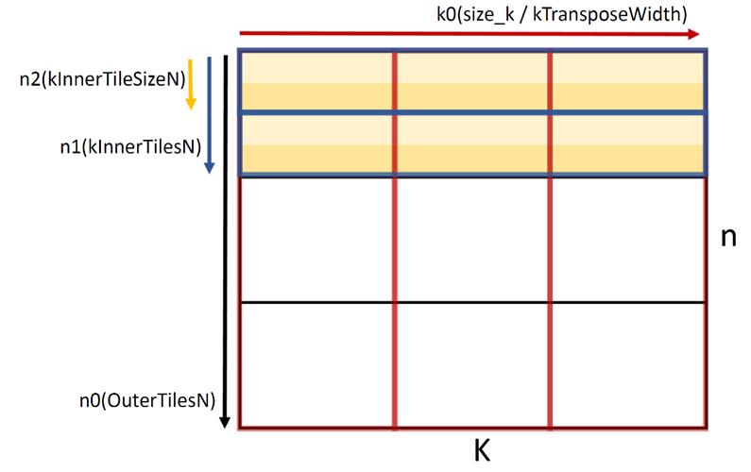
Read A
A

Slide 8
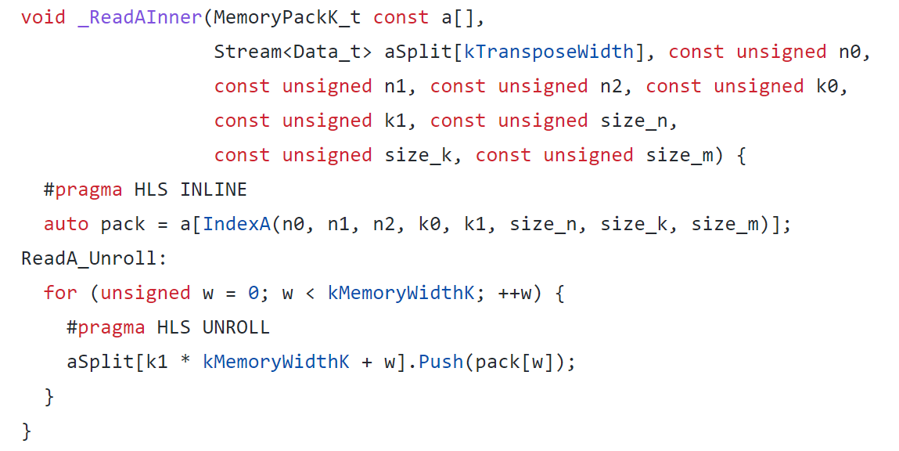
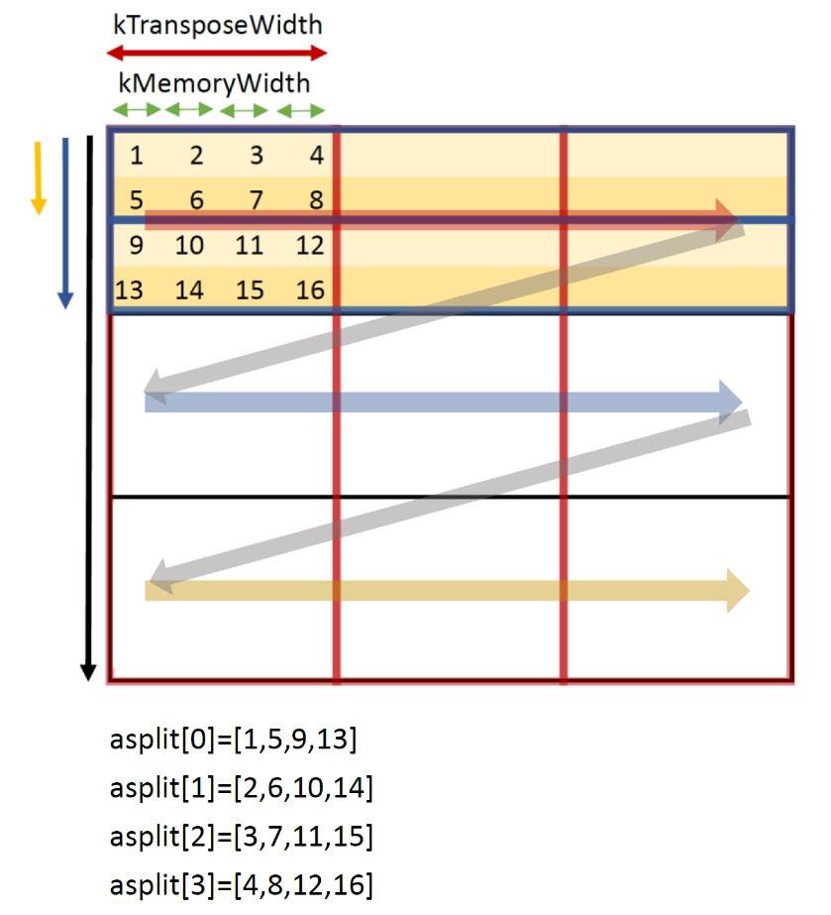
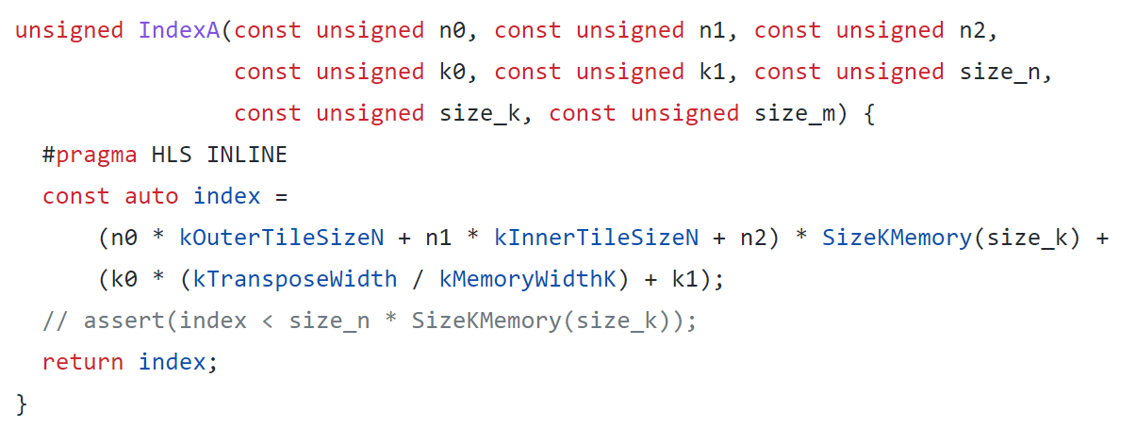
Read A
A
n
k

Slide 9

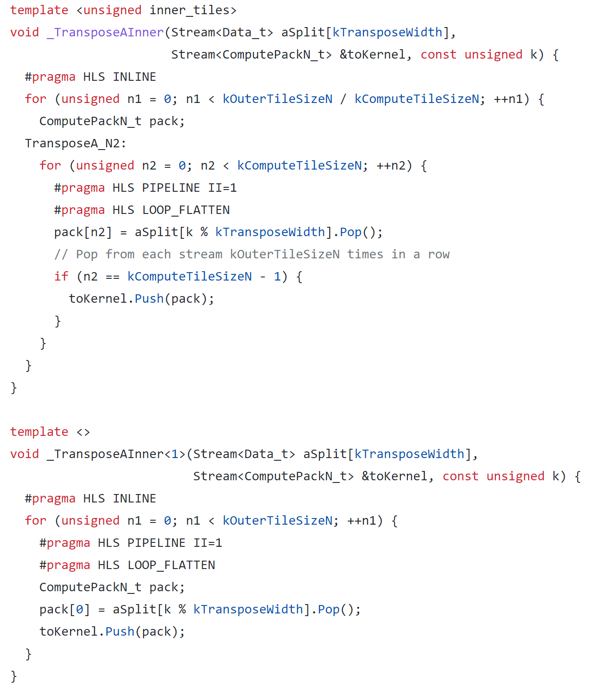

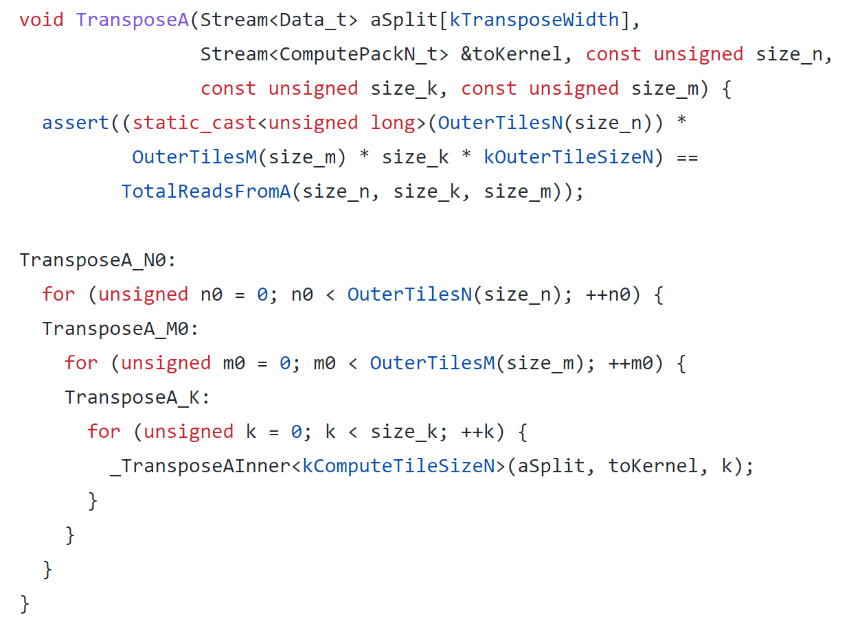
Transpose

Slide 10
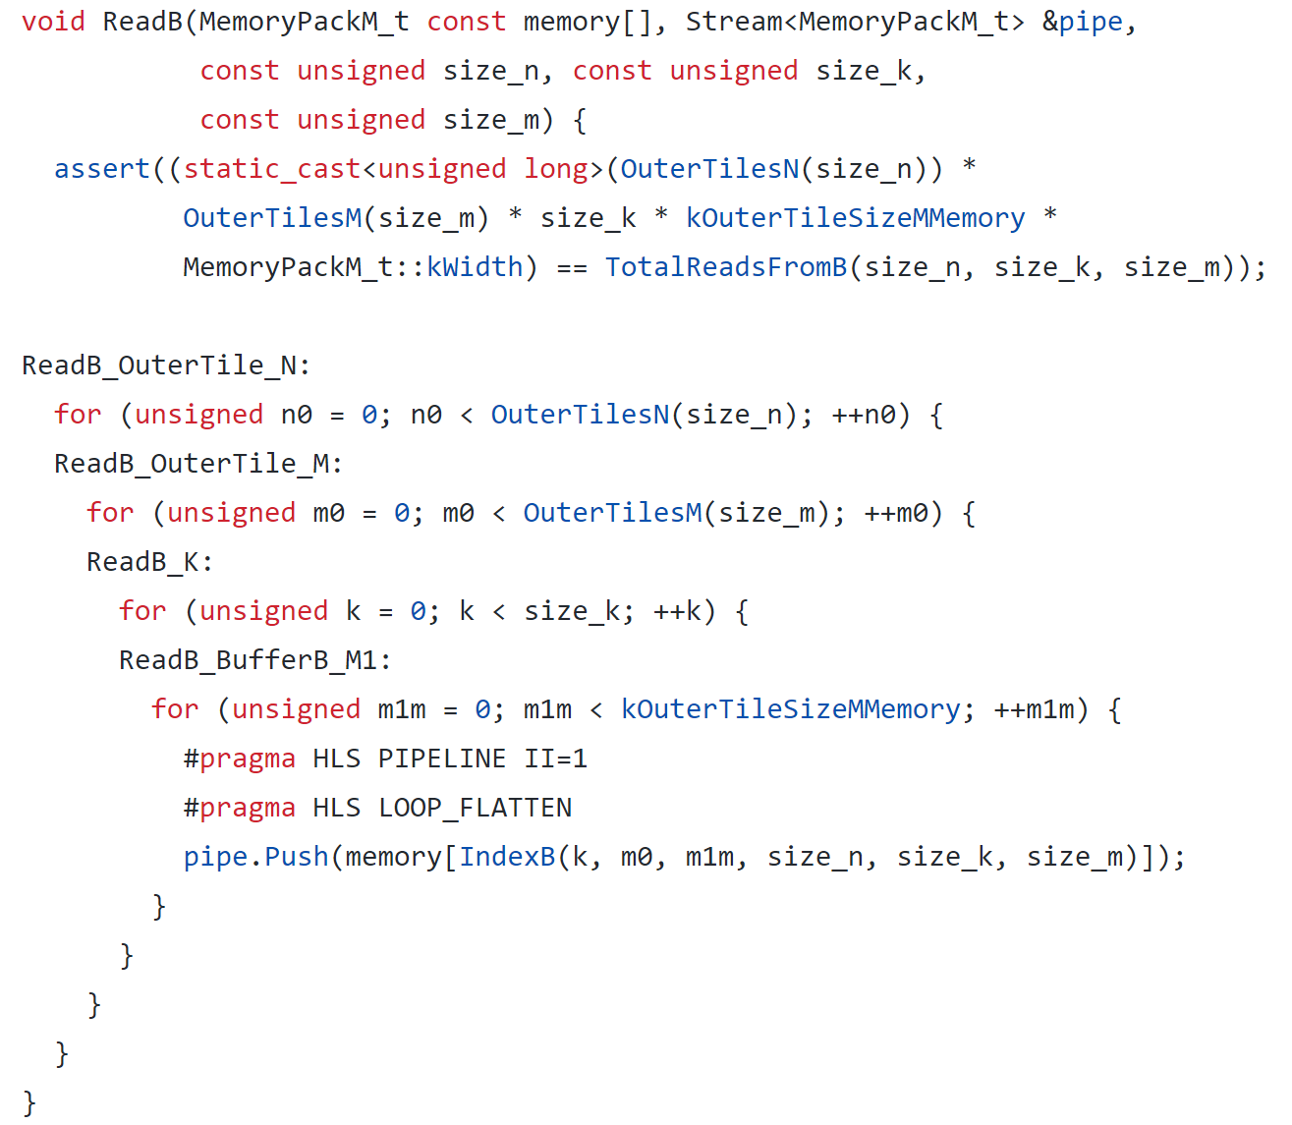
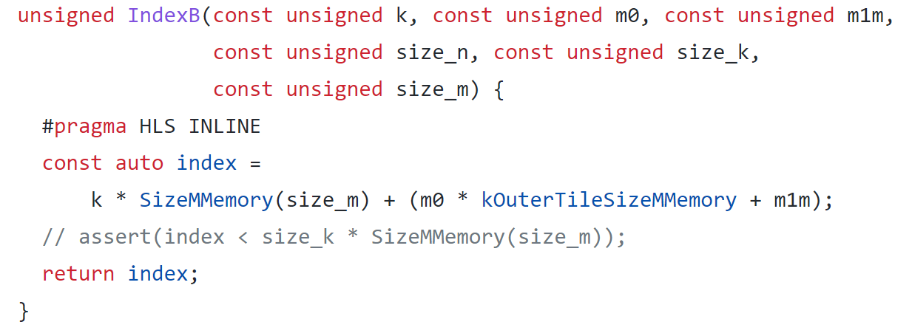
Read B

Slide 11
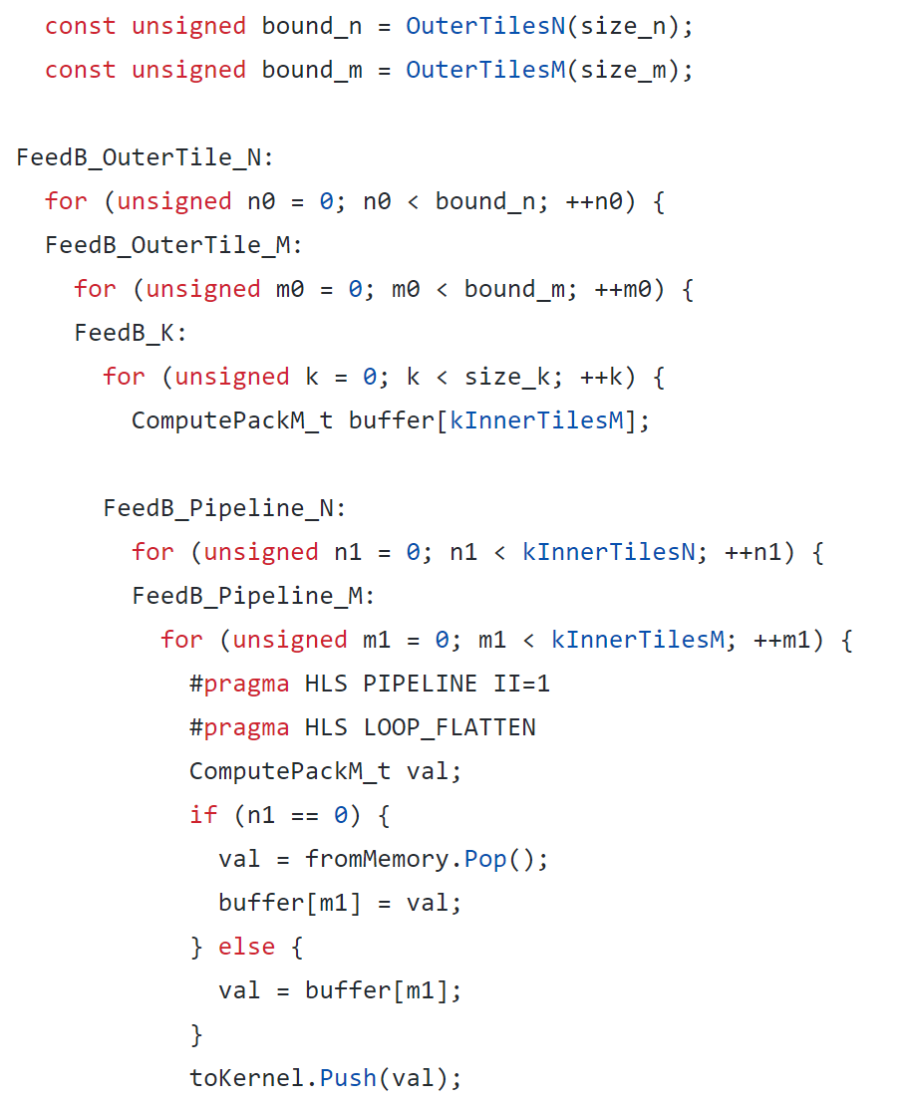
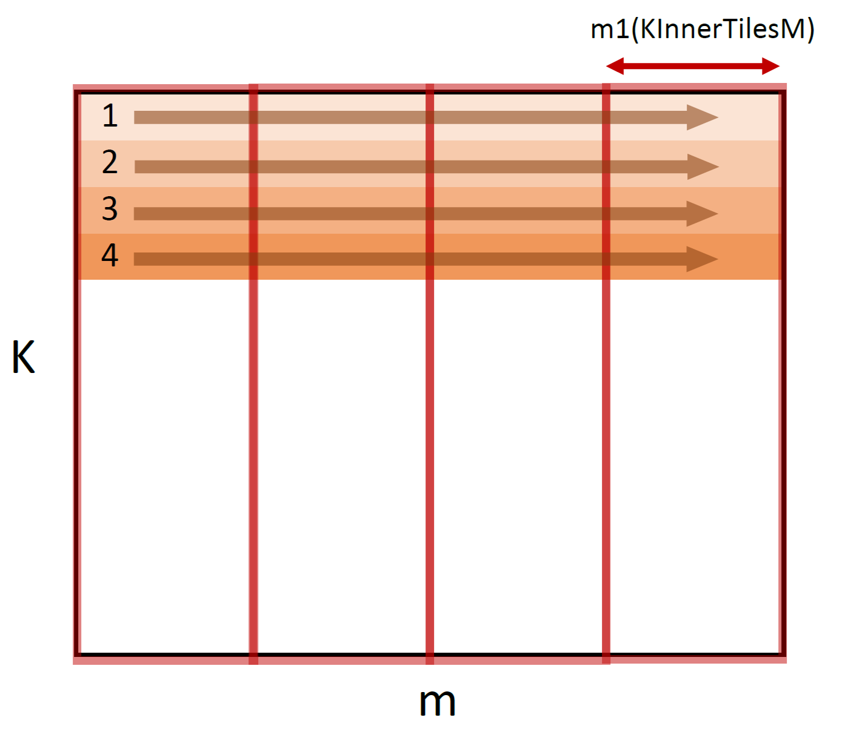

Feed B

Slide 12
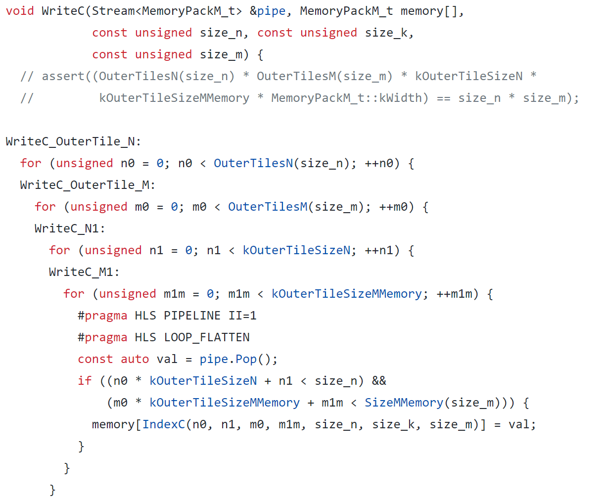
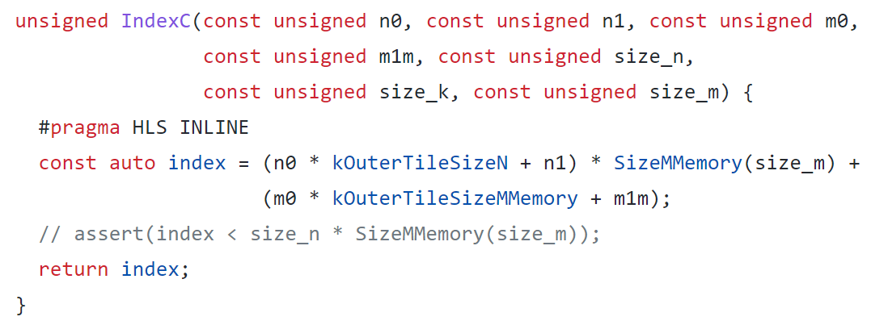
Write C

Slide 13
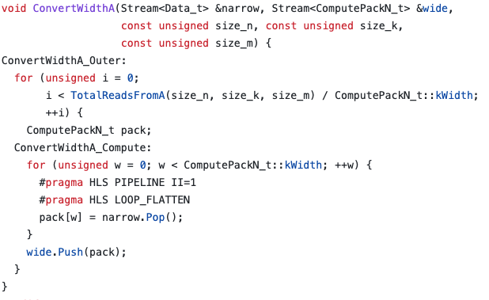
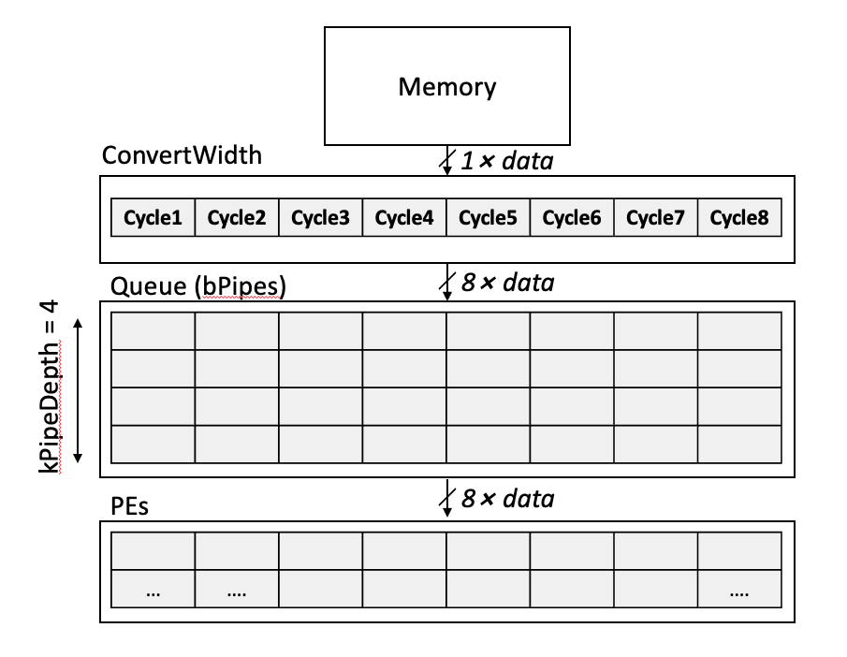
Convert Bitwidth

Slide 14
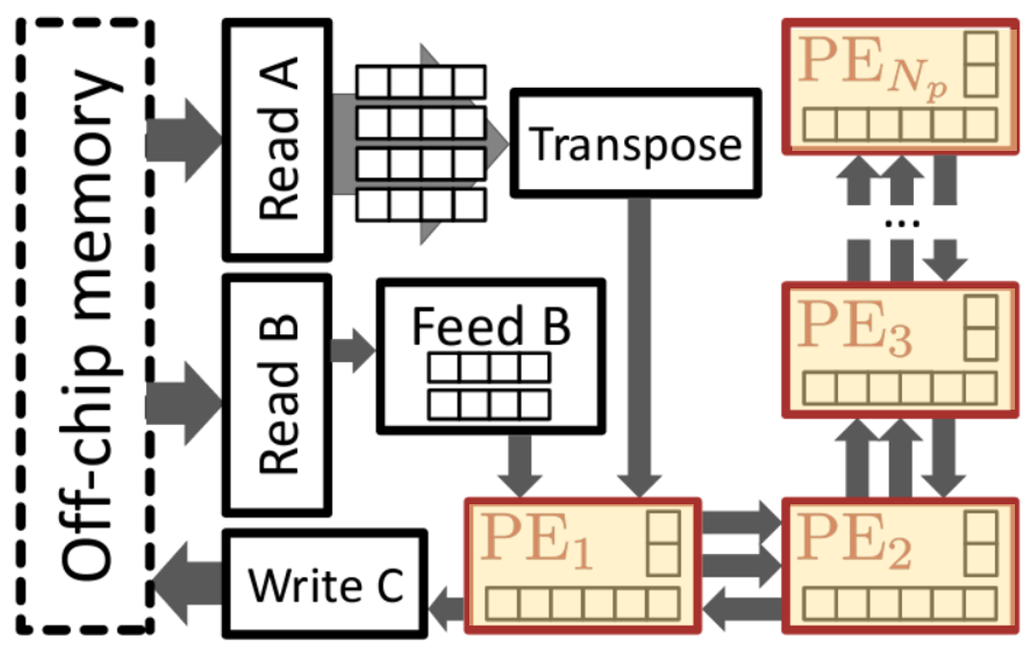
Compute-related

Slide 15
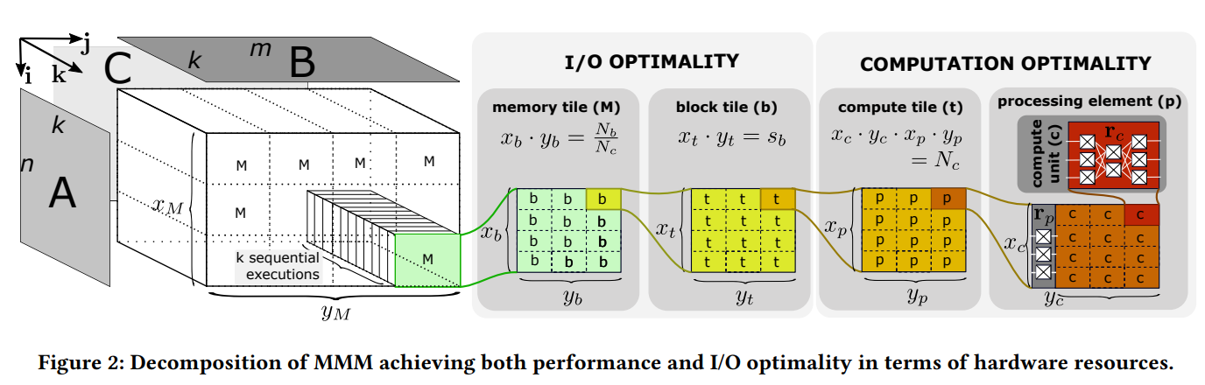
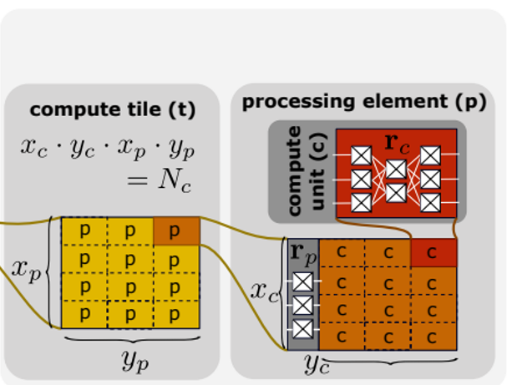
Processing Elements
64
kInnerTilesM
8
kComputeTileSizeM
512 kOuterTileSizeM
kComputeTileSizeN=1
kOuterTileSizeN
512
kInnerTilesN
16
kComputeTilesN
32

Slide 16
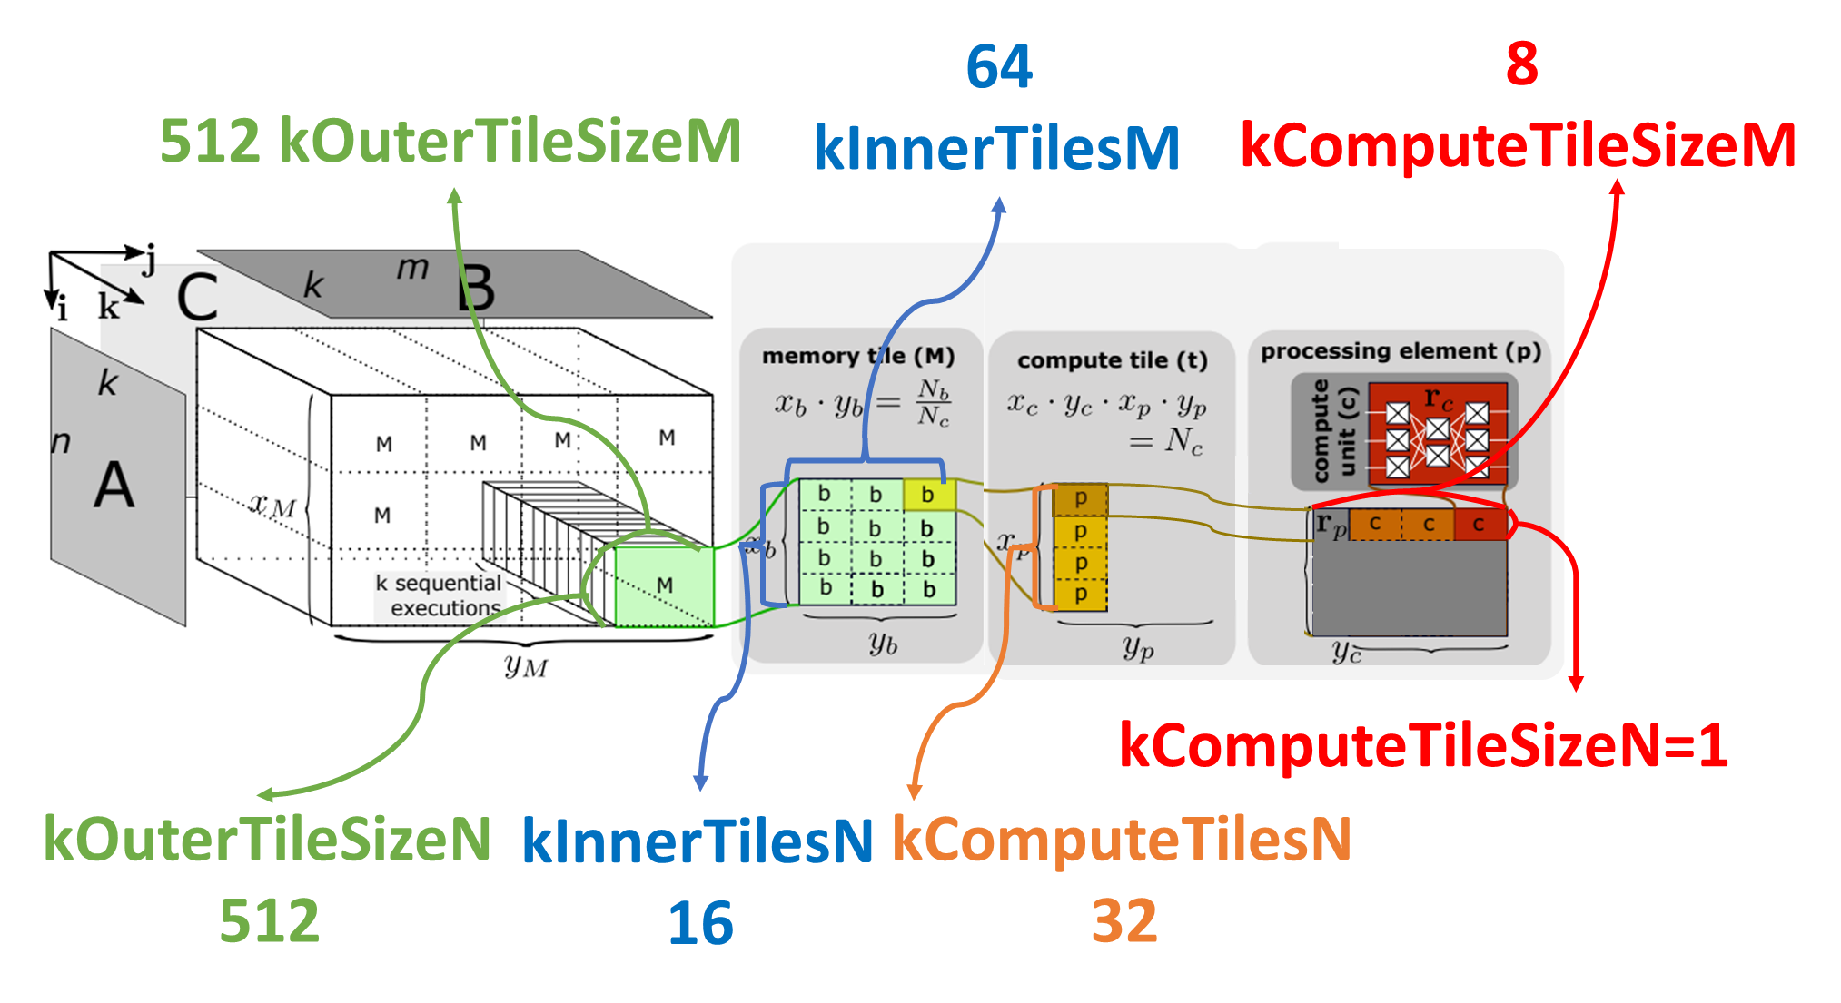
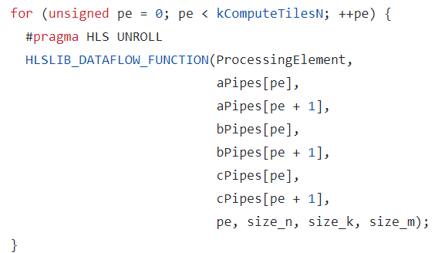
Processing Elements
aPipes[0]
aPipes[1]
aPipes[31]
bPipes[0]
bPipes[1]
bPipes[31]
PE1
PE2
PE32
cPipes[0]
cPipes[1]
cPipes[31]

Slide 17
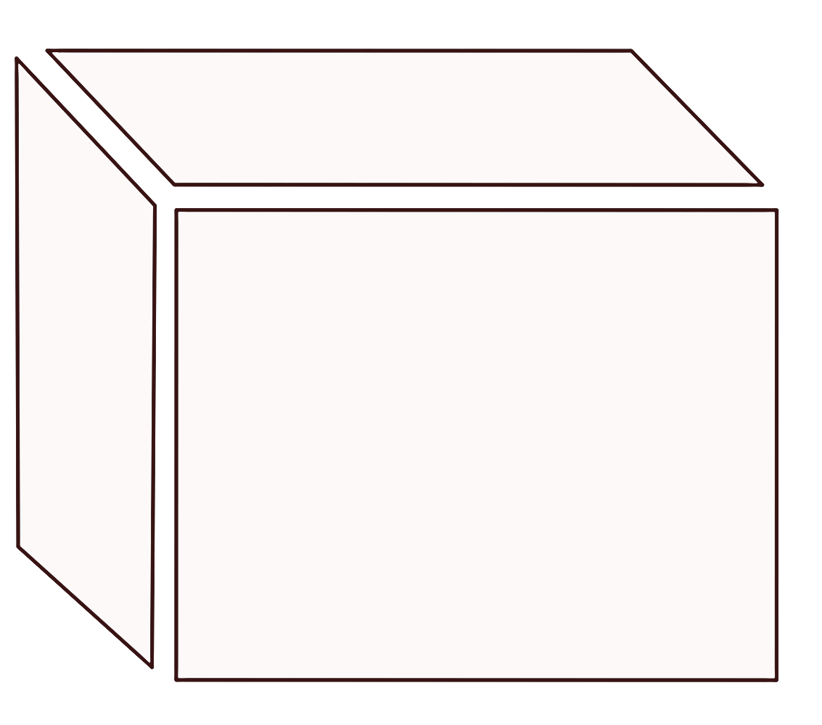
Processing Elements
m=1024
m0
④
n=1024
B0
B1
B2
A0
⑤
A0B0
A0B1
A0B2
③
A1
k
A1B0
A1B1
A1B2
n0
A2
A2B0
A2B1
A2B2
m1
①
A0
A1
B0
B1
B2
B7
k=1024
A32
A0
(A1024)
c0
c1
c2
c7
PE1
②
A33
n1
A1
(A1025)
c0
c1
c2
c7
PE2
A31
(A1055)
c0
c1
c2
c7
PE32

Slide 18
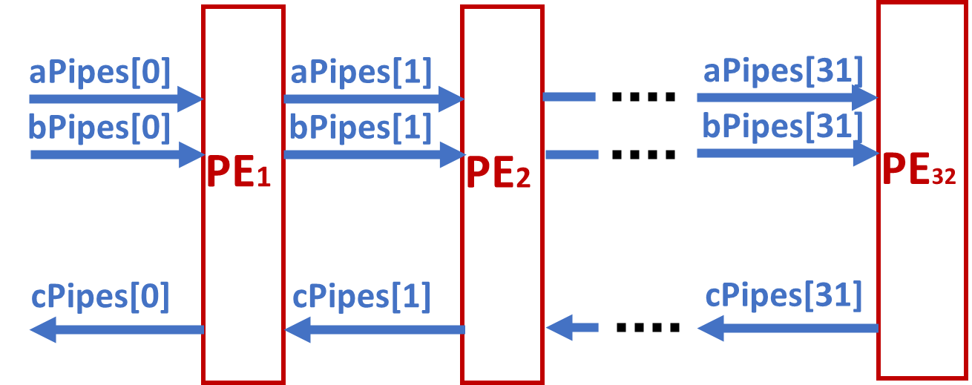
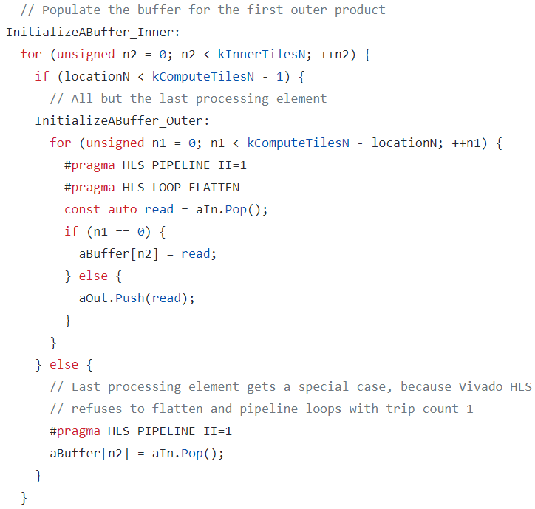
Processing Elements Initialize
k 1024
A0
A1024
n
1024
A1
A1025
aPipes[0]=[0,1,2,3,4,…,511]
Pe=0
aBuffer[32]=[0, 32, 64, 96, ……, 480, 0,…, 0, 0]
aPipes[1]=[1, 2, 3, …, 31, 33, …, 481, 482, …, 511]
Pe=1
aBuffer[32]=[1, 33, 65, 97, ……, 481, 0, …, 0, 0]
aPipes[2]=[2, 3, …, 31, 34 , …, 482, …, 511]
Pe=2
aBuffer[32]=[2, 34, 66, 98, ……, 482, 0, …, 0, 0]
aPipes[3]=[3, …, 31, 35 , …, 483, …, 511]

Slide 19
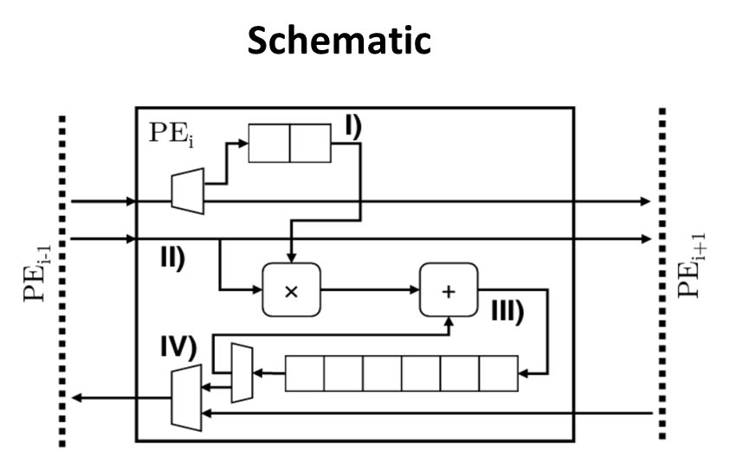
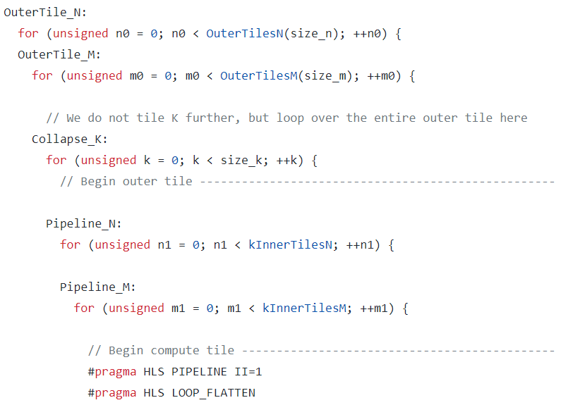
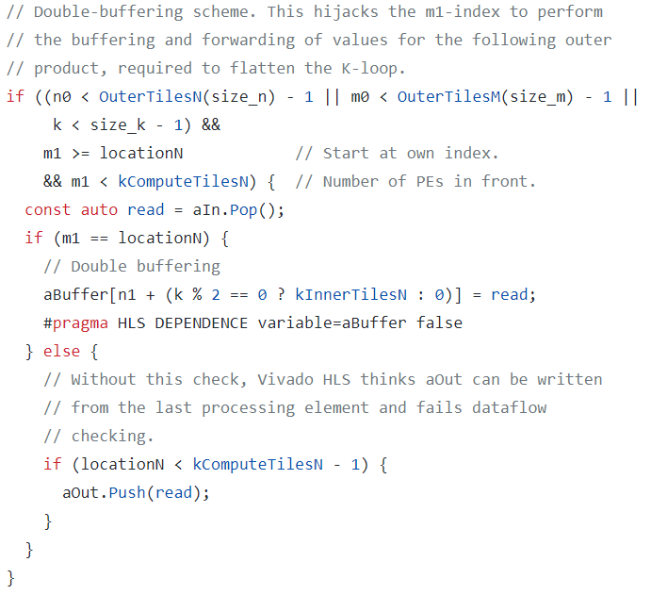
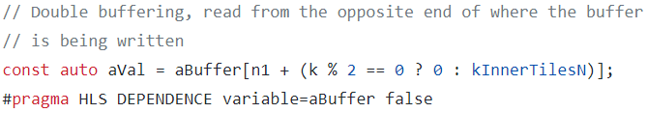
Processing Element Part I
Odd k
Even k
aVal
Even k
Odd k
Pe=0
aBuffer[32]=[[0], [32], [64], [96], ……, [480], [1024],…, [1472], [1504]]
aPipes[1]=[1, 2, 3, …, 31, 33, …, 481, 482, …, 511, 1025, 1026, …, 1505, 1506, …, 1535]
Pe=1
aBuffer[32]=[[1], [33], [65], [97], ……, [481], [1025],…, [1473], [1505]]
aPipes[2]=[2, 3, …, 31, 34 , …, 482, …, 511, 1026, …, 1506, …, 1535]

Slide 20
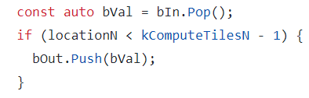
Processing Element Part II
bVal
bIn size = kComputeTileSizeM = 8
m1=0
bVal = [0, 1, 2, 3,….., 7]
bPipes[1]=[0, 1, 2, 3,….., 7]
m1=1
bVal = [8, 9, 10, 11, …, 15]
bPipes[1]=[[0, 1, 2, 3,….., 7], [8, 9, 10, 11, …, 15]]

Slide 21
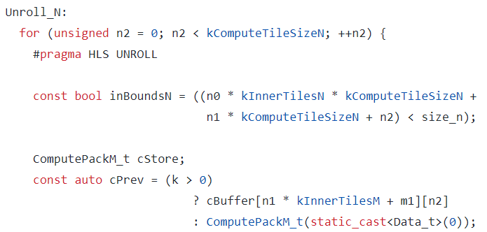
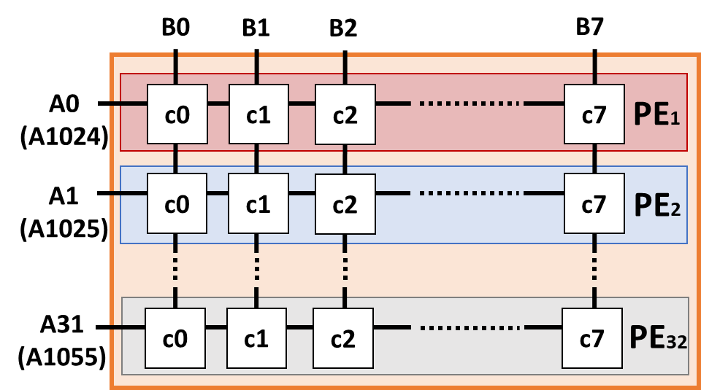
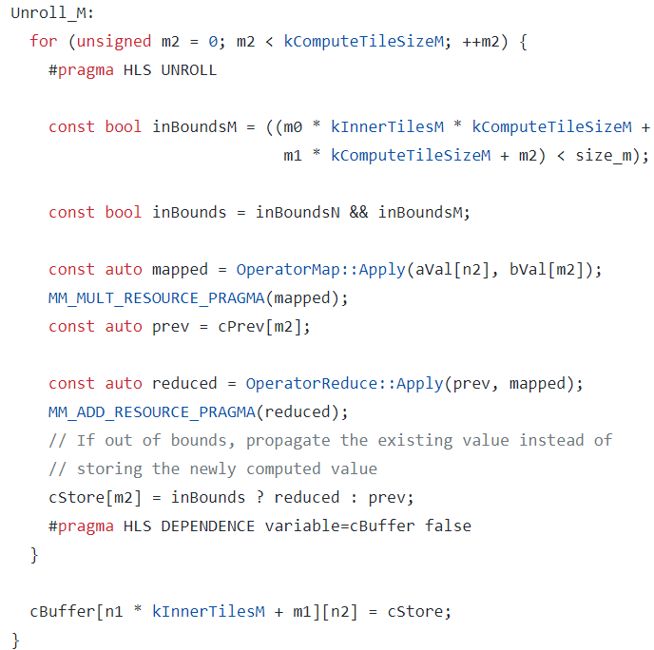
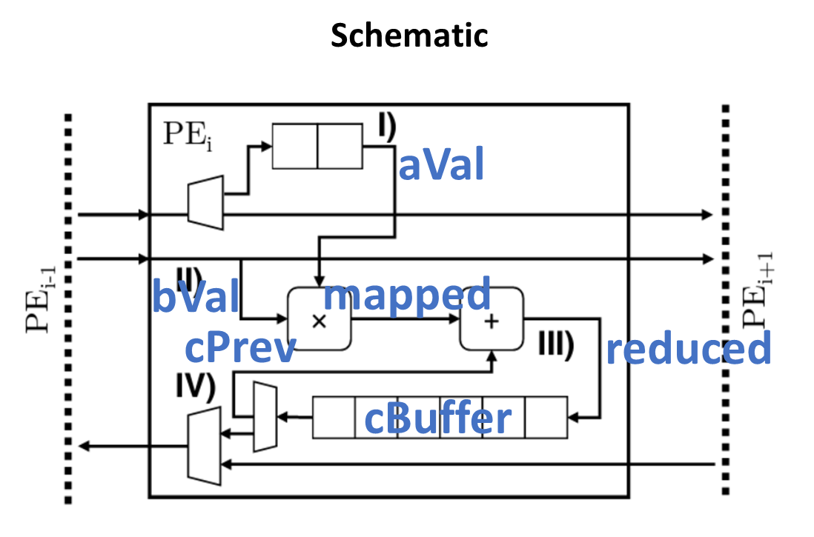
Processing Element Part III

Slide 22
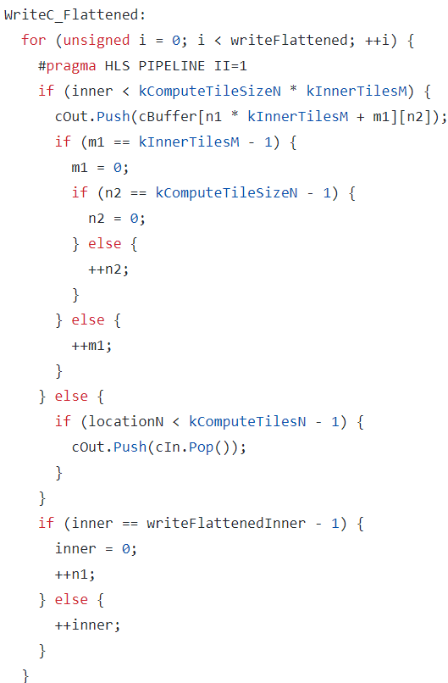
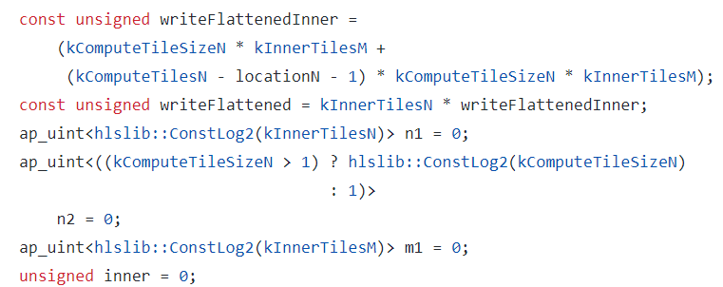
Processing Element Part IV
64
C0
C1
C63
C64
C65
C127
c0
c1
c2
c7
C2048
C2049
C2111
C2112
C2112
C2175
16
32

Slide 23
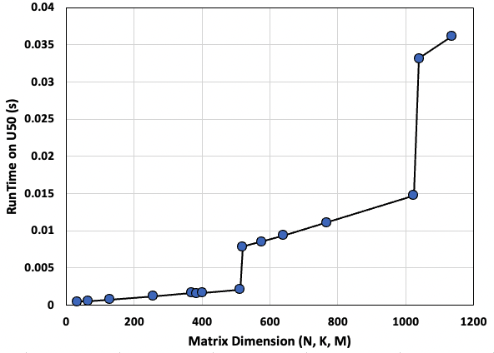
Empirical Results

Slide 24
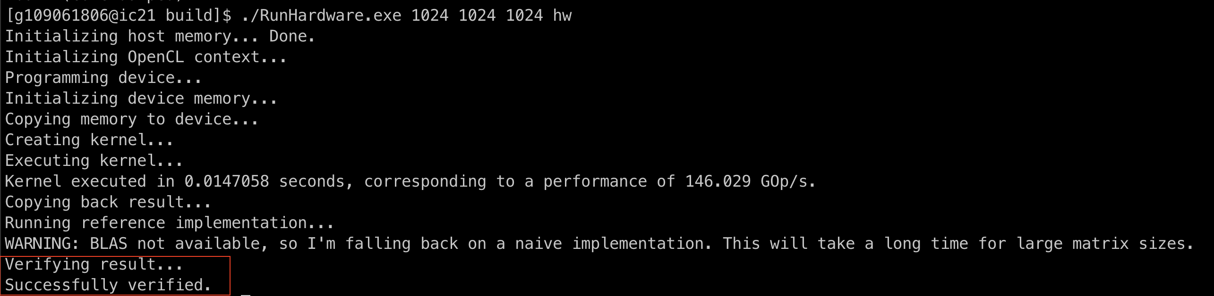
Conclusions
This work partitions matrix into tiles to support various size of matrix multiplication workloads
We thoroughly study the HLS code structure to understand the architecture and how to design it
We successfully port accelerator to U50 board
We run extensive evaluations to find potential optimizations

